Slide 1
Enterprise Data Architect Case Study:
Data Platform Transformation for AI

Slide 2
The Challenge (The Situation & Mandate)
Our multi-tenant data platform is currently blocked from achieving AI capabilities due to legacy architectural debt. Mandate
is to provide strategic and technical suggestions to our team on how to execute the full transformation.
Problem | Explanation (The Pain) | Strategic Impact (CSO)
Variable Schema & Embedded Data | Our platform is low-code/no-code, meaning the schema is customer-specific for the same application. Data is highly nested, and critical Master Data is embedded. | Cost & Scale: Leads to massive duplication, requires complex, inefficient processing logic, and drives high cloud costs.
Monolithic Lock-in & Efficiency | The system is proprietary and inefficient, operating in batch and preventing migration to cost-effective OSS Spark/Kubernetes. | Cost & Latency: Blocks near real-time data flow, preventing cloud cost optimization.
Low Latency Block | We cannot consistently process data at the required 5-10 minute latency needed for real-time AI features and conversational agents. | Observability & AI: Hinders proactive monitoring and makes predictive use cases impossible.

Slide 3
The SOLUTION AREAS
The Foundational Fix: Data Layering, Decoupling, and Cost
Achieving Real-Time Performance and Scalability
Open-Source Transition, Observability, and Metadata
Strategic Pivot: Data for AI and Agent Services
Key discussion points

Slide 4
The Foundational Fix: Data Layering, Decoupling, and Cost

Slide 5
Architectural Suggestion
Medallion Architecture
Bronze Layer (Raw/Landing)
Immutable, append-only storage of raw data as ingested
Preserves complete audit trail and enables replay capability
Handles variable schemas via schema-on-read patterns
Silver Layer (Cleansed/Conformed)
Schema enforcement and validation
Master data extraction and normalization occurs here
Change Data Capture (CDC) processing for incremental loads
Gold Layer (Semantic/Feature)
Business-oriented, denormalized aggregates
Optimized for consumption (Analytics + AI)
Pre-computed features for ML models

Slide 6
Separation Strategy for variable schema
Approach: Parameterized Schema Registry + Dynamic Parser
Schema Registry Implementation:
  Central registry mapping tenant_id → schema_version → field_mappings
  JSON/Avro schema definitions per customer variant
  Version control for schema evolution
Master Data Extraction Process:
Bronze → Schema Detection → Master Data Extractor (Parameterized) → Silver
Parameters:
- Tenant configuration (which fields = master data)
- Extraction rules (XPath/JSONPath for nested data)
- Normalization mappings (customer_specific_field → canonical_field)
Lossless Fidelity Guarantee:
  Maintain Bronze layer with complete raw data (permanent audit trail)
  Use hash-based validation checksums at each layer transition
  Implement reconciliation framework comparing record counts and key metrics

Slide 7
Cost justification
Immediate Savings from De-duplication:
Example: If Customer entity is embedded in 10 transaction types, each with 500K daily records
Current State: 5M redundant customer records stored daily
Post-Normalization: ~50K unique customer records + 5M lightweight references
Storage Reduction: ~99% for master data components
Compute Reduction: Eliminate redundant transformations on duplicated data
Real-World Impact:
40-60% reduction in storage costs (S3/ADLS)
30-50% reduction in compute time (fewer data movements)
Improved cache efficiency (deduplicated data fits in memory)

Slide 8
Modelling pattern
Possible Solution: Hybrid Data Vault + Feature Store
Gold Layer Design:
For Analytics (Data Vault 2.0):
Hubs: Unique business keys (Customer, Product, Order)
Links: Relationships between entities (Customer-Order, Order-Product)
Satellites: Descriptive attributes with temporal tracking
Benefits: Handles schema changes, maintains history, supports multi-source integration
For AI (Feature Tables):
Entity-centric feature tables derived from Vault
Temporal features (30-day avg order value, customer lifetime metrics)
Real-time feature materialization for inference
Point-in-time correctness for training data

Slide 9
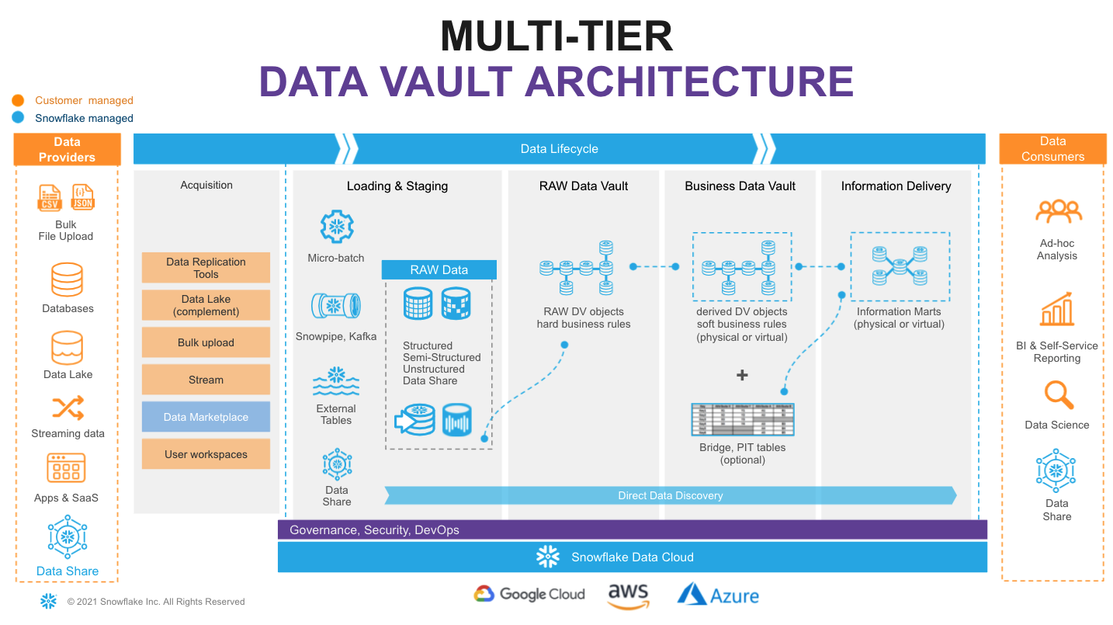

Slide 10
Achieving Real-Time Performance and Scalability

Slide 11
Approach: Lambda → Kappa Architecture Evolution
Phase 1: Hybrid Lambda (Quick Win)
Batch: OSS Spark for historical processing (Bronze → Silver)
Speed: Flink/Kafka Streams for incremental updates (last 24-48 hours)
Serving: Merge views in Gold layer
Phase 2: Pure Kappa (Target State)
Unified stream processing (Flink on Kubernetes)
Event-driven, continuous processing
Achieves 5-10 minute end-to-end latency

Slide 12
Critical PoCs (Prioritization)
PoC #1: OSS Spark on Kubernetes + Iceberg/Delta Lake
Objective: Validate monolithic processing logic migration
Success Criteria:
  Reproduce current batch outputs with 100% accuracy
  Demonstrate 30%+ cost reduction vs. proprietary system
  Prove Kubernetes autoscaling for variable workloads
Timeline: 4-6 weeks
De-risks: Vendor lock-in, compute costs, infrastructure modernization
PoC #2: Flink Streaming for High-Frequency Incremental Updates
Objective: Achieve sub-30-minute latency for critical data flows
Success Criteria:
  Process 200K+ records/hour with <10 min end-to-end latency
  Handle out-of-order events and late arrivals correctly
  Demonstrate exactly-once processing semantics
Timeline: 6-8 weeks
De-risks: Real-time requirements, event ordering, state management

Slide 13
Scalability Strategy
Horizontal Scalability:
Partitioning: By tenant_id and event_timestamp
Parallelism: Dynamic partition count based on data volume
State Management: Distributed state backend
High Availability:
Checkpointing: Regular state snapshots (every 5 minutes)
Multi-region replication for critical Gold layer data
Circuit breakers for dependent application data flows
Kafka as buffer to decouple producers/consumers and handle backpressure
Handling Data Dependencies:
Watermarking strategy for time-based joins across applications
Windowed joins with configurable late-arrival tolerance
Fallback patterns (serve stale data vs. block on missing dependencies)

Slide 14
Open-Source Transition, Observability, and Metadata

Slide 15
Risk mitigation
Critical Migration PoCs
Already Covered in slide #12, Expanded Here:
PoC #1 - Extended Scope:
Logic Translation: Convert proprietary ETL to PySpark/Scala
Performance Benchmarking: Same input → same output, 1.5x faster target
Resource Optimization: Right-size Kubernetes pods (CPU/memory profiling)
PoC #3 (Additional): Schema Evolution & Backward Compatibility
Objective: Validate schema registry handles customer-specific changes
Test: Add new field to 10 tenants, ensure no breaking changes to downstream
Success: Zero-downtime deployment, automated schema migration

Slide 16
Manifest pattern design - observability
Architecture:
Event Source → Manifest Creation → Processing → Manifest Update → Serving
Manifest Table Schema:
{
manifest_id: UUID,
tenant_id: String,
source_system: String,
batch_id: String,
record_count: Long,
start_time: Timestamp,
end_time: Timestamp,
status: Enum(RECEIVED, PROCESSING, COMPLETE, PAUSED, FAILED),
quality_checks: JSON {
schema_valid: Boolean,
null_check_pass: Boolean,
duplicate_count: Int
},
layer: Enum(BRONZE, SILVER, GOLD),
lineage: Array[manifest_id] (parent manifests)
}
Purpose & Capabilities:
Granular Control:
  Pause/resume specific tenant data flows via status flag
  Replay from specific manifest_id for data corrections
  Rollback to previous manifest in case of issues
Enhanced Observability:
  Real-time dashboard showing processing status per tenant
  SLA monitoring (time in each layer)
  Quality metrics trend analysis
  End-to-end lineage tracking (source → Gold)
Operations Benefits:
  Root cause analysis (which manifest introduced bad data?)
  Capacity planning (processing time trends)
  Customer-specific SLA reporting

Slide 17
Metadata Knowledge Base Strategy
Architecture: Centralized Data Catalog + Knowledge Graph
Components:
Technical Metadata (DataHub etc.)
  Schema definitions (fields, types, constraints)
  Physical location (table paths, partitions)
  Lineage (upstream/downstream dependencies)
  Statistics (row counts, null percentages, cardinality)
Business Metadata
  Non-technical names ("Customer Lifetime Value" vs. "cust_ltv_amt")
  Descriptions and calculation logic
  Data ownership and stewardship
  Sensitivity classification (PII, confidential)
Tenant-Specific Configuration
{
tenant_id: "customer_A",
application: "ERP",
schema_version: "2.1.3",
field_mappings: {
"cust_ref_id" → "customer.external_id",
"total_amt" → "order.total_amount"
},
join_conditions: {
order_to_customer: "order.cust_ref_id = customer.external_id"
}
}
Knowledge Graph Layer (Neo4j etc)
  Entity relationships across applications
  Semantic search capabilities
  Traversal for impact analysis
Critical for Conversational AI:
Natural Language Query Translation:
User: "What's the average order value for premium customers this month?"
System:
1. Lookup "average order value" → metric_definition → calculation logic
2. Lookup "premium customers" → customer.segment = 'premium'
3. Lookup "this month" → time_filter → current_month()
4. Generate SQL from metadata + execute
Context-Aware Responses:
  Understands tenant-specific field names
  Applies correct join paths based on schema version
  Surfaces data quality caveats from manifest metadata

Slide 18
Strategic Pivot:
Data for AI and Agent Services

Slide 19
Architectural Bridge to AI
How Low-Latency Foundation Enables AI:
Real-time Feature Freshness:
  Sub-30-minute latency ensures model inputs reflect current state
  Critical for fraud detection, dynamic pricing, recommendation engines
Normalized Data Access:
  Master data separation enables consistent entity definitions
  Reduces feature engineering complexity (no duplicate resolution logic)
Observability Infrastructure:
  Manifest pattern provides training data lineage
  Enables point-in-time feature reconstruction for model debugging

Slide 20
Feature Store Conceptual Flow
DATA PLATFORM LAYERS
Bronze (Raw) → Silver (Normalized) → Gold (Semantic)
FEATURE STORE
Feature Engineering Pipeline (Spark/Flink)
- Aggregations (rolling windows)
- Transformations (embeddings, encodings)
- Joins (entity-centric feature assembly)
OFFLINE STORE (Historical)
- Parquet/Delta
- Training Data
- Batch Scoring
ONLINE STORE (Real-Time)
- Redis/Memcache
- <10ms lookups
- Inference
Model Training (Offline)
Conversational Agent
(Real-Time Inference)

Slide 21
Why Feature Store is Necessary
Dual-Timeline Consistency:
  Training: Point-in-time correct features (no data leakage)
  Inference: Fresh features with <100ms latency
  Challenge: Same feature definition, different serving requirements
Conversational Reporting Agents Needs:
  Low Latency: User asks question → response in <2 seconds
  Pre-computed Features: Can't run complex aggregations on-the-fly
  Contextual Awareness: Agent needs customer segments, behavioral features instantly
Reusability & Governance:
  Single source of truth for feature definitions
  Version control for features (reproducibility)
  Feature discovery (avoid duplicate engineering)
Example Use Case:
User to Agent: "How are my high-value customers trending?"
Agent Workflow:
1. Retrieve from Feature Store (online):
- customer_segment features (cached)
- 30_day_purchase_trend (pre-computed, refreshed every 30 min)
- customer_lifetime_value (materialized)
2. Generate natural language response with visualization
Total latency: <1 second (vs. 5+ minutes if computing from scratch)

Slide 22
Key discussion points

Slide 23
CSO Trade-offs: Data Quality vs. Latency
Philosophy: "Quality gates should be asynchronous and non-blocking for real-time paths.“
Implementation:
Multi-tier Quality Framework:
  Tier 1 (Blocking): Critical schema validation, null checks on primary keys → Silver layer entry gate
  Tier 2 (Warning): Statistical anomalies, referential integrity → logged in manifest, data flows through
  Tier 3 (Async): Deep quality rules, ML-based outlier detection → run post-processing, backfill corrections
Quarantine Pattern:
  Failed records routed to quarantine zone (S3/separate table)
  Main pipeline continues unblocked
  Operations team reviews and reprocesses quarantine batch
Progressive Quality:
  Bronze → Silver: Basic validation (5-10 min latency maintained)
  Silver → Gold: Richer quality checks asynchronously
  Gold layer: Highest quality guaranteed, but may lag by additional 10-15 minutes
Result: Achieve <30-minute latency for 99.5% of clean data, while maintaining high quality bar.

Slide 24
Team & leadership structure
Initial PoC Team (3-month sprint):
Core Roles:
PoC Lead (Architect) - Overall technical direction
Data Engineer (2) - PoC #1 execution
Data Engineer (1-2) - PoC #2 (Flink) execution
Platform Expert (2) - Domain knowledge, validation
Data Engineer (1) - Manifest pattern, observability
DevOps/SRE (1) - K8s infrastructure, CI/CD
Knowledge Transfer Strategy:
Phase 1 (Weeks 1-4): Learn & Shadow
External consultants/OSS experts pair with existing team
Daily standups focused on "why" not just "how"
Hands-on workshops (Spark optimization, K8s debugging)
Phase 2 (Weeks 5-8): Collaborate & Build
Existing team leads feature development with OSS stack
Consultants provide code reviews and best practices
Weekly architecture review sessions
Phase 3 (Weeks 9-12): Own & Extend
Existing team runs PoC demos to stakeholders
Begin onboarding additional team members
Document patterns, runbooks, troubleshooting guides
Cultural Shift:
Celebrate "unlearning" proprietary approaches
Reward contributions to shared OSS knowledge base
Hackathons focused on OSS ecosystem exploration

Slide 25
Business Quantification: Cloud Cost Savings
Conservative Estimate: 35-50% Total Platform Cost Reduction
Breakdown (Back of the envelope calculation):
1. Master Data De-duplication (Immediate):
Current State: 5M records/day with 60% embedded redundancy
Post-Normalization: 2M records/day
Storage Savings: 60% reduction × $0.023/GB/month × 10TB = ~$8K/month
Compute Savings: 40% fewer transformations = ~$15K/month
Subtotal: ~$275K/year
2. OSS Migration (6-12 months):
Proprietary License Elimination: ~$500K/year
Kubernetes Autoscaling: 30-40% compute efficiency vs. fixed VMs = ~$200K/year
Spot Instances for Batch: Additional 50-70% savings on batch compute = ~$150K/year
Subtotal: ~$850K/year
3. Operational Efficiency (12-18 months):
Reduced Manual Interventions: Better observability = 50% less ops time = ~$100K/year
Faster Troubleshooting: Manifest pattern reduces MTTR = reduced downtime costs
Total Annual Savings: $1.2M - $1.5M (35-50% of estimated $3M annual platform cost)
Additional ROI:
Time-to-Market: 3-6 months faster for new AI features = competitive advantage
Revenue Enablement: Conversational AI could drive 5-10% upsell/cross-sell = $XM (business-dependent)

Slide 26
Summary : key success​ metrics
Technical:
  Sub-30-minute end-to-end latency (95th percentile)
  99.9% data quality score (post-Silver layer)
  Zero vendor lock-in (100% OSS stack)
Business:
  40%+ cloud cost reduction
  Enable 3+ AI use cases in Year 1
  50% reduction in schema change deployment time
Operational:
  <5 minute MTTR for data flow issues (manifest pattern)
  100% lineage coverage for compliance
  Self-service feature creation for data scientists
This architecture positions the platform as an AI-ready, cost-efficient, observable foundation for next-generation data products.

Slide 27
THANKS

